Slide 1
CAR ACCIDENT PREDICTION MODEL

Slide 2
BACKGROUND
The main aim of building a prediction model for car severity is to help government authority responsible to road transport safety to derive insight and take due actions such as safety boards, street light facility, road repair etc on road based where there is high prediction of severe accidents is high.
This prediction model can also be leveraged by car derivers get insight and take more care and caution while driving based on accident severity prediction model.
This prediction model will use sample data of car collisions/accidents from a city and use the same to predict accident severity based on factors from the sample data such as address type, road junction type, light condition, weather condition and road condition.

Slide 3
Data & TOOLS
Sample data is of accident information.
It provides accident severity along with several features including address type, junction type ,light condition, weather condition and road condition etc. associated with the accident record.
We will use these features and check if prediction model for accident severity can be built based on these features to help government authority to take measure to avoid the severe accidents.
Severity of accident is what we will try to build a prediction model for based on the features.
Input Data: The dataset used in this project is provided at the link is: https://s3.us.cloud-object-storage.appdomain.cloud/cf-courses-data/CognitiveClass/DP0701EN/version-2/Data-Collisions.csv
Description of data:
SEVERITYCODE- Injury Collision, Property Damage are the two categories.
ADDRTYPE - Collision address type: • Alley • Block • Intersection
WEATHER- A description of the weather conditions during the time of the collision
ROADCOND- The condition of the road during the collision
LIGHTCOND - The light conditions during the collision.
Python : backend coding and logic implementation
Logistic Regression
Jupyter Notebook : used for executable

Slide 4
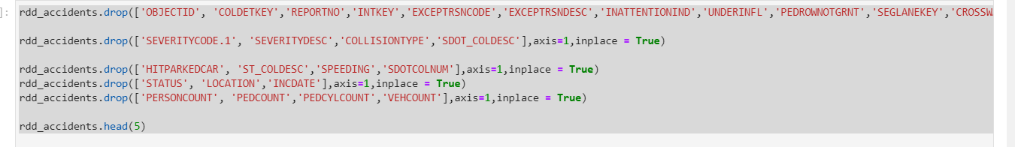
Methodology Used:
Data Cleaning : We have only used factors mentioned in Data section, which are SEVERITYCODE, ADDRTYPE, WEATHER, ROADCOND and LIGHTCOND in our prediction model. Therefore rest of the columns have been dropped.

Slide 5
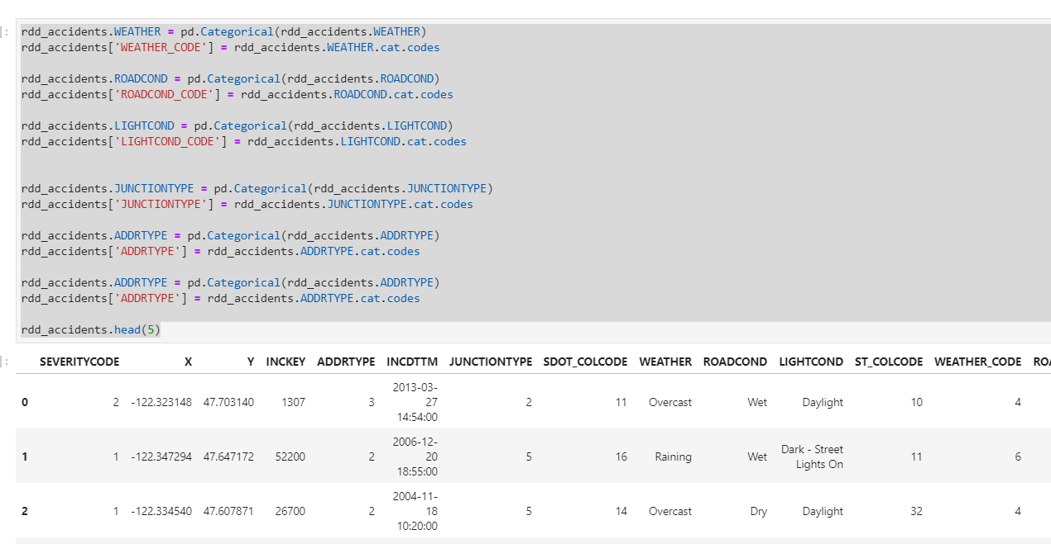
Methodology Used:
Convert Data Type: Check the types of the data in interested features. ADDRTYPE, WEATHER, ROADCOND and LIGHTCOND text values are converted to category codes for each. We had categorical data that was of type 'object'. This is not a data type that we could have fed through an algoritim, so label encoding was used to created new classes that were of type int8; a numerical data type.

Slide 6
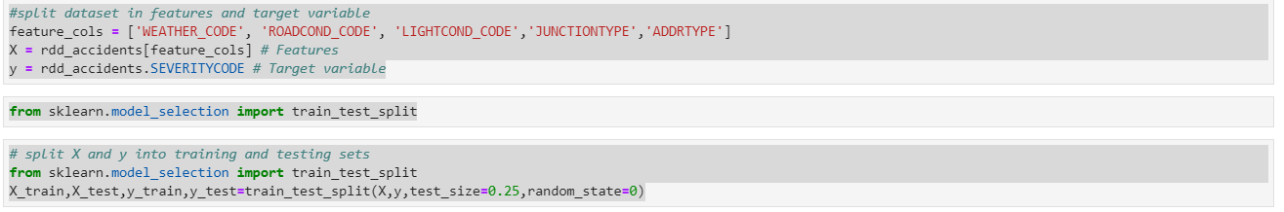
Methodology Used:
Split data into feature and target variable
Splitting Data set into train and test : Data was split into train and test in ratio 75% : 25%.

Slide 7
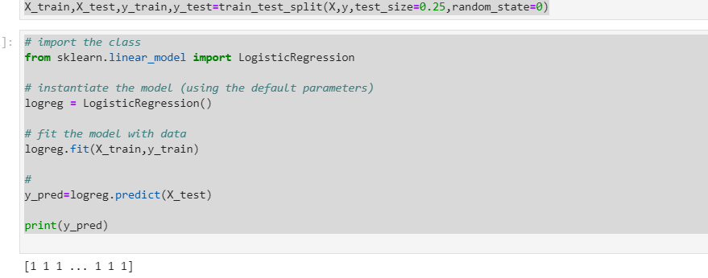
Methodology Used:
Prediction Model: K Means and Logistic regression models have been used to derive prediction model for accident severity. Both the models' accuracy and precision have been checked and found that using logistic regression a good prediction model for accident severity based on features- light condition, weather condition and road condition can be built. For train/test split, we used 70% of the data for training and 25% of the data for testing. For logistic regression, we used the LogisticRegression() function from sklearn.linear_model to train the model, the C value is set to 1 and the solver is set to ‘liblinear’.

Slide 8
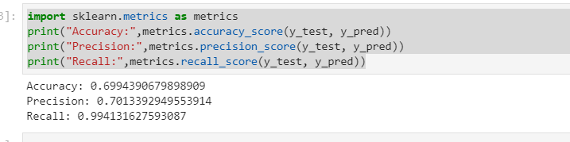
Methodology Used:
Testing accuracy and precision of the prediction:

Slide 9
Result
The result is not as good as we expected, the accuracy of both models is not very high, possibly due to the lack of features. Therefore, we conclude that location, condition, and time provided by the dataset have some impact on the severity of an accident.

Slide 10
Conclusion
This work highlights that machine learning techniques can be used to probe historical data in order to make reliable predictions about the outcome of road traffic accidents, given information which is available at the time when an accident is reported.
This model can be extended to include new features or applied to accident databases in other cities/regions. By doing so, city planners can gain insight into the road conditions/features which are associated with high accident severity, and use this insight to improve road design.
Additionally, by predicting accident severity as functions of weather, date, location and road conditions, this model may be able to help aid the decision making of emergency services call handlers, by allowing them to prioritize resources toward collisions with a greater likelihood of severe consequences.

